Slide 1
Database Project:
Air Passenger Arrival Database System
Group member:
Jordan Gho Jun Sheng (2200564)
Oh Jiang Yi (2200548)
Tan Jeng Siang Joel (2201062)
Yeo Chin Seng Samuel (2201066)
Yuan Yucheng (2203365)
Notes:
Good morning. Our team consists of Jordan, Jiang Yi, Joel (myself), Samuel, and Yucheng. Our database project focuses on developing an air passenger arrival database system

Slide 2
Table of Content
Introduction
Implementation (CRUD)
Implementation (Complex Functions)
Constraints
Video demonstration
Tan Jeng Siang Joel
Notes:
This is our table of contents: We will begin with an introduction, followed by the system architecture design and requirements, overall system architecture, implementation phases, discussion, and finally, a video demonstration of our GUI.

Slide 3
Background
Air Passenger Arrival Data Management System
Transforming fragmented data into actionable insights:
Unifies air passenger information
Enables real-time arrival analysis
Empowers data-driven tourism management
Boosts efficiency and potential revenue
Tan Jeng Siang Joel
Notes:
The Air Passenger Arrival Data Management System is an innovative solution that consolidates fragmented air passenger data into a unified, real-time database. By integrating information on arrivals, origins, stay duration, and airlines, it provides tourism authorities with powerful tools for data-driven decision-making. This system enables more effective resource allocation, targeted marketing, and improved tourist experiences, ultimately fostering sustainable tourism practices and potentially boosting tourism revenue.

Slide 4
System Requirement
Entity | Description | Attributes
Passenger | Stores essential details about visitors travelling to Singapore. | pid INT (PK) ,Name VARCHAR(50) , Age INT, Gender VARCHAR(2), lid VARCHAR(15) (FK), aid VARCHAR(15) (FK), cid VARCHAR(20) (FK)
Countries | Store information about visitor numbers by country. | cid VARCHAR(20), ccount INT
Airlines | Store information about visitors numbers by airline. | aid VARCHAR(15) acount INT
Length_of_Stay | Store information about how long visitors stay in Singapore. | lid VARCHAR(15) loscount INT
Table 1: Entity-Description-Attributes
Tan Jeng Siang Joel
Notes:
This slide presents the key entities in our air passenger arrival database system.
We have four entities: Passenger, which stores visitor details like name, age, gender, and references to country, airline, and length of stay. Countries records visitor numbers by country, Airlines tracks visitor numbers by airline, and Length_of_Stay stores data on how long visitors stay in Singapore.
These entities ensure our system can efficiently manage and analyze passenger data, supporting detailed queries for insights."

Slide 5
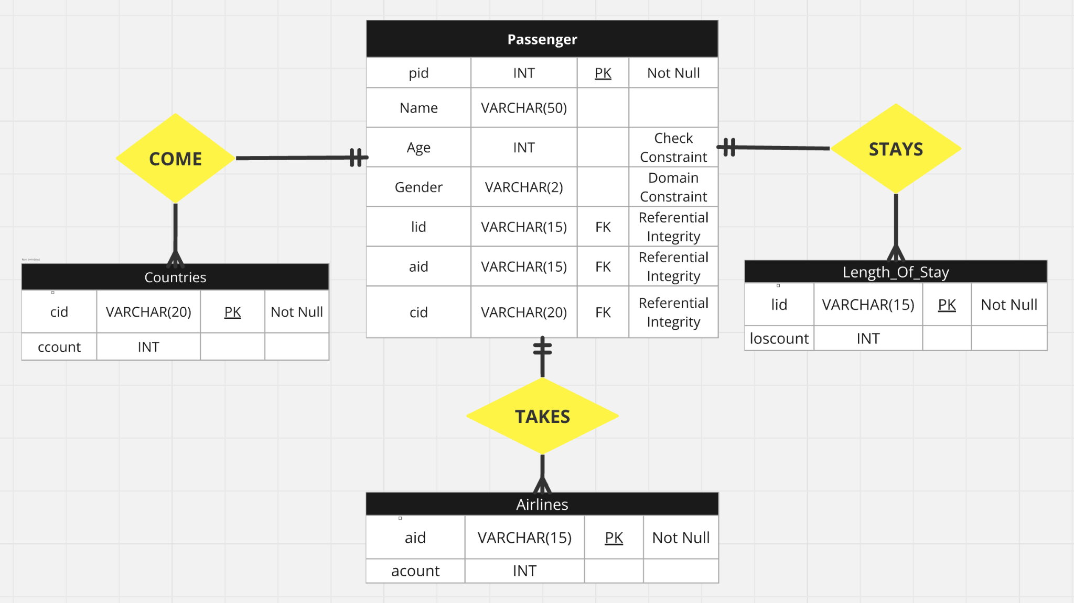
ER Diagram
Fig 2: ER Diagram
Jordan Gho Jun Sheng
Notes:
This is our Entity Relationship Diagram
In total we have 4 entities and 3 relationships which is One to Many

Slide 6
Implementation (CRUD functions)
Functionality | Description
Create Passenger by Name, Age, Gender, Length of Stay, Airline, Country | Allow system to add passenger arrival data to any of the tables
Read Passenger Arrival by Name, Age, Gender, Length of Stay, Airline, Country | Allow system to view amount of passenger depending on the tables
Update Passenger by Name, Age, Gender, Length of Stay, Airline, Country | Allow system to update passenger arrival data from any of the tables
Delete Passenger by Name, Age, Gender, Length of Stay, Airline, Country | Allow system to remove passenger arrival data from any of the tables
Table 2: CRUD Functions
Jordan Gho Jun Sheng
Notes:
This database management system consists of 4 basic and 3 advanced features
BAsics is CRUD Function refer back to ER Diagram

Slide 7
Implementation (Complex functions)
Functionalities | Description
Analyse Airline Popularity | Compares passenger counts across airlines entering Singapore to determine the most popular carriers. Generates a visualisation of airline popularity based on incoming visitor data.
Analyse Tourism Duration | Categorising lengths into ranges and identify the most common duration. Provides insights for tailoring tourism strategies based on visit lengths.
Analyse Airline Trend | Analyses and identify relationships and trends between passenger country of origin and airlines, travel routes and airline preferences through comparative data analysis and charting.
Table 3: Complex Functions
Jordan Gho Jun Sheng
Notes:
Advanced Features include
Analyse Airlie Popularity: Compare passenger count across airlines that entering singapore and determine the most popular one
Analyse Tourism Duration : Categories length of stay in ranges to identify the most common stay durationbased on visit lengths and allowing the users of this dbms to tailor tourism strategies
Analyse Airline Trend: Identify relationships and trends between country of origin and airlines for analysis of travel routes and airline preferences through comparative data

Slide 8
Constraints
Fig 3: Primary Key and foreign keys “passengers” table
Fig 4: Primary Key ”length_of_stay” table
Fig 5: Primary Key ”countries” table
Fig 6: Primary Key ”airplanes” table
Yuan Yucheng
Notes:
Now I will be talking about the constraints. The primary Key Constraint ensures that each rows in a table is uniquely identifiable, for example pid
Not Null Constraint Ensure ensures that a column cannot have NULL values especially for primary keys like. pid, enforces that certain fields must always have a value
Then for Foreign Key Constraint it is to Establish a relationship between two tables, restricting actions that would invalidate the relationship

Slide 9
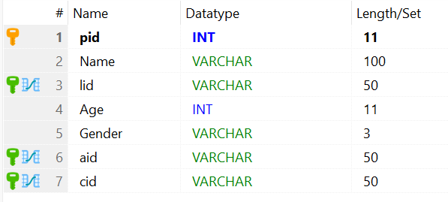

Constraints
Fig 7: Referential Integrity
Fig 8: Check Constraints for Age and Gender
Yuan Yucheng
Notes:
Referential Integrity Foreign key constraints ensure data consistency across tables while Domain Constraint Ensure that an attribute’s value must come from a predefined set or domain for example Gender attribute restricting to (‘M’, ‘F’). In this case we used a Check Constraint to enforce domain integrity by limiting the values that can be placed in a column or set of columns

Slide 10
Video Demonstration
Oh Jiang Yi & Yeo Chin Seng Samuel
Notes:
This will conclude our presentation, now we will move on to our video demonstration.

